Slide 1
Arduino & Robotics

Slide 2
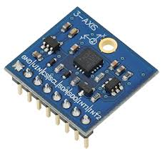
What We learn in this session
How to learn development of electronic systems
What is Embedded System
What is Arduino
Why Arduino
How to program Arduino
Introduction to EDA tools

Slide 3
How to learn development of electronic systems
How I can get information of so many components available in the electronics market.
Datasheet.
Learning previously developed circuit.
Develop practical setup for system.
Take help of Google BABA (Internet) and
available experts.

Slide 4
What is Embedded System

Slide 5
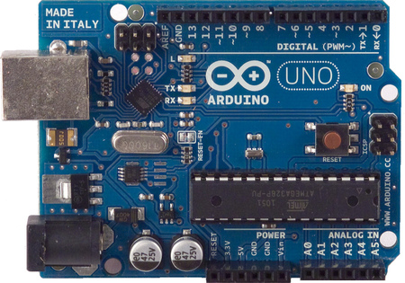
Arduino

Slide 6
What is Arduino?
A programmable micro controller board for prototyping electromechanical devices
We can connect Digital and Analog electronic signals:
Sensors (Gyroscopes, GPS Locators, accelerometers)
Actuators (LEDS or electrical motors)

Slide 7
Why Arduino?
Easy to learn
Programming material and source codes are available
Open Source
Program burning is very easy.

Slide 8
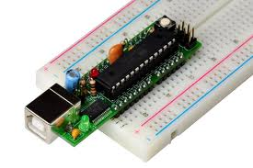
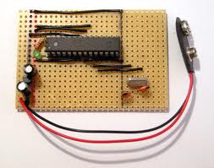
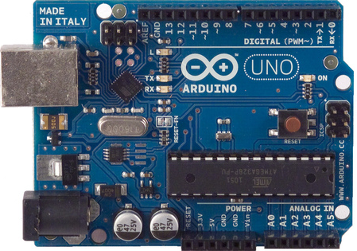
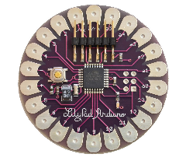
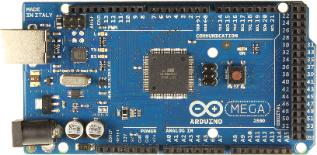
Different types of Arduinos
Boarduino Kit
DIY Arduino
Arduino Uno
Arduino LilyPad
Arduino Mega 2560

Slide 9
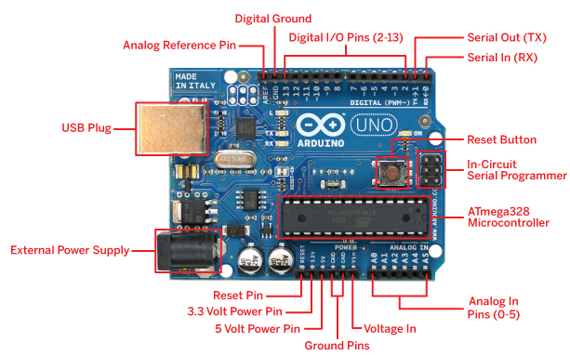
Arduino Components

Slide 10
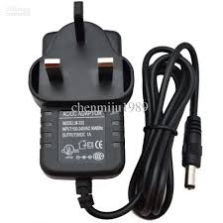
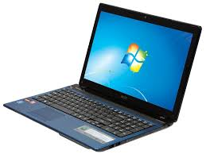
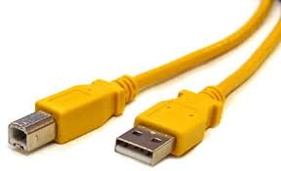
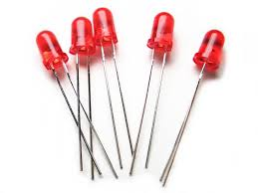
What do we need?

Slide 11
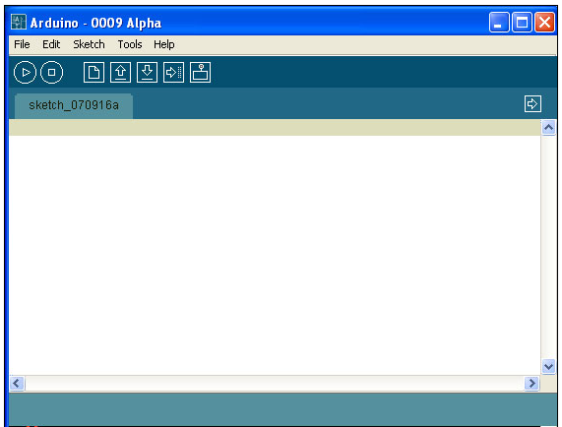
1.- Download and install the Arduino Software

Slide 12
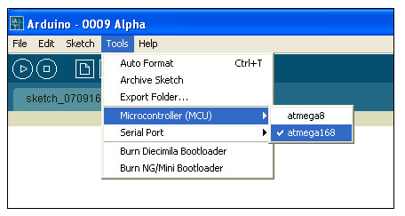
2.- Configure the Arduino software for the correct chip
(Select the Microcontroller)

Slide 13
Arduino Integrated Development Environment (IDE)
Two required functions / methods / routines:
void setup()
{
// runs once
}
void loop()
{
// repeats
}

Slide 14
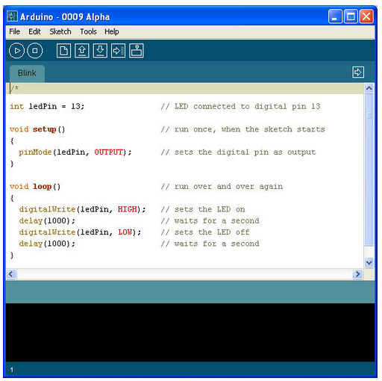
Input
Program Notification Area
Status Bar

Slide 15
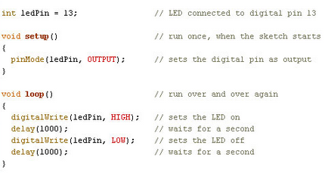
Code

Slide 16
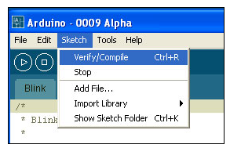
5.- Verify/Compile
6.- Once it compiles, you must see the following messages in the Status bar and the Program notification Area

Slide 17
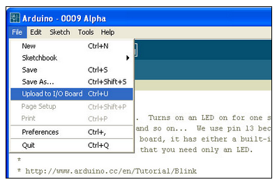
7.- Upload it
8.- Once it upload, you must see the following messages in the Status bar and the Program notification Area

Slide 18
Error
avrdude: stk500_getsync(): not in sync: resp=0x00
can't open device "COM10": The system cannot find the file specified

Slide 19
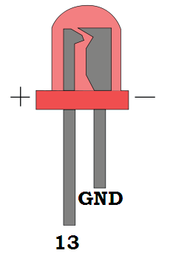
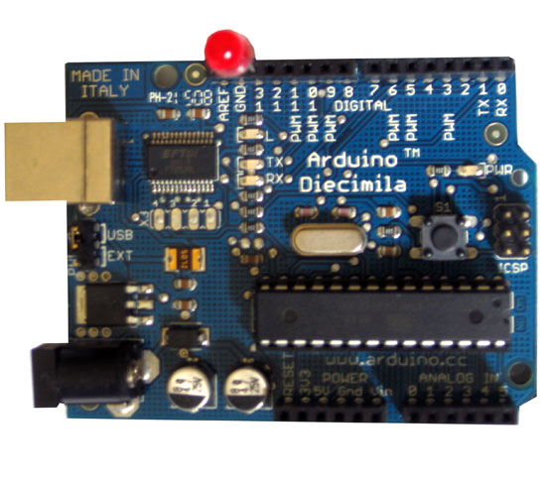
9.- Insert LED
It is blinking!!!

Slide 20
Applications
http://www.youtube.com/watch?v=8dynrQvF_bE
http://www.youtube.com/watch?v=mw__gOjdyYI
http://www.youtube.com/watch?v=SmJEjFWXl1s

Slide 21
Introduction to EDA tools

Slide 22
Summery
Way to develop electronics systems
What is Embedded System
Brain of Embedded System(Arduino)
EDA tool

Slide 23
Thank You
9552811938 (Whats App. No.)
Join Us at Facebook
Mdb electrosoft
Youtube Channel “Mdb electrosoft”
www.mdbelectrosoft.in

