Slide 1
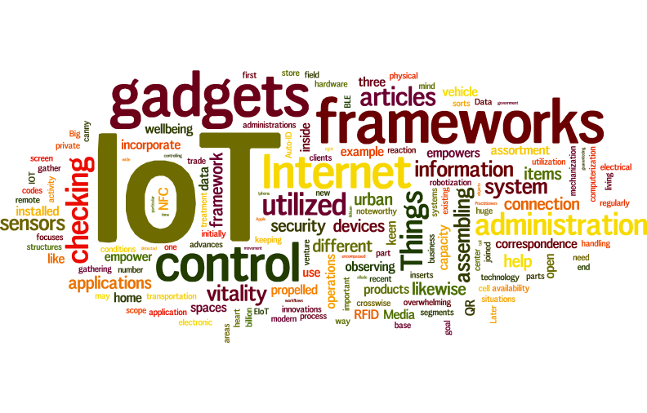
Internet of Things

Slide 2
What is IoT?
The Internet of Things (IoT) is the network of physical objects—devices, vehicles, buildings and other items embedded with electronics, software, sensors, and network connectivity—that enables these objects to collect and exchange data.

Slide 3
What is IIOT
Machines will communicate with each other and with operator through Internet

Slide 4
IOT Architecture
Cloud
Transmitter / Receiver
Transmitter / Receiver

Slide 5
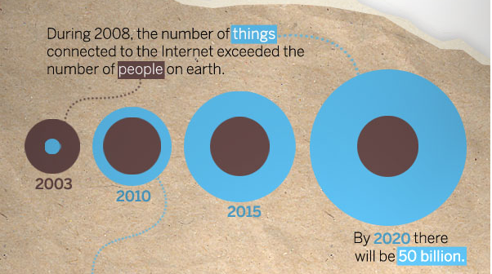
“Thing” connected to the internet
Image Courtesy: : CISCO
5

Slide 6
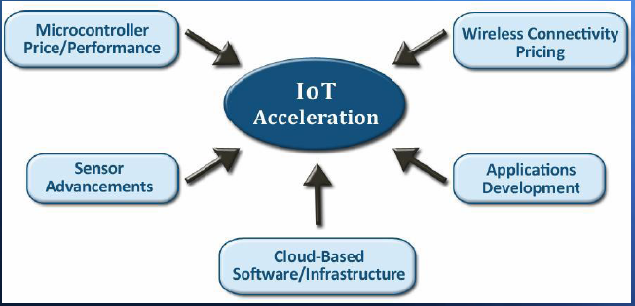
Requirement Of IoT

Slide 7
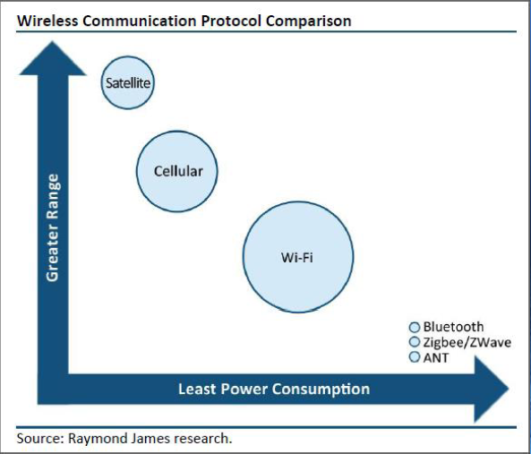
Driver of IoT connectivity

Slide 8
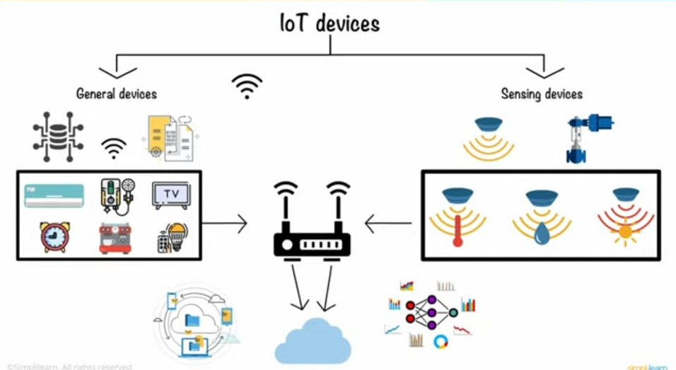

Slide 9
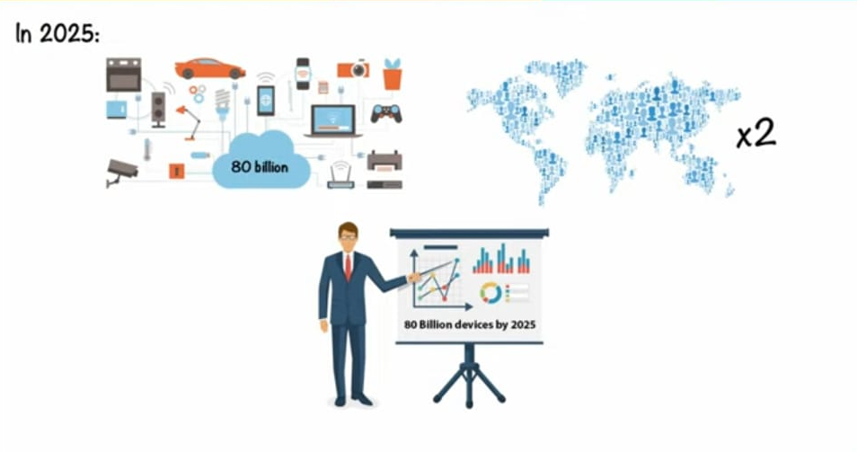

Slide 10
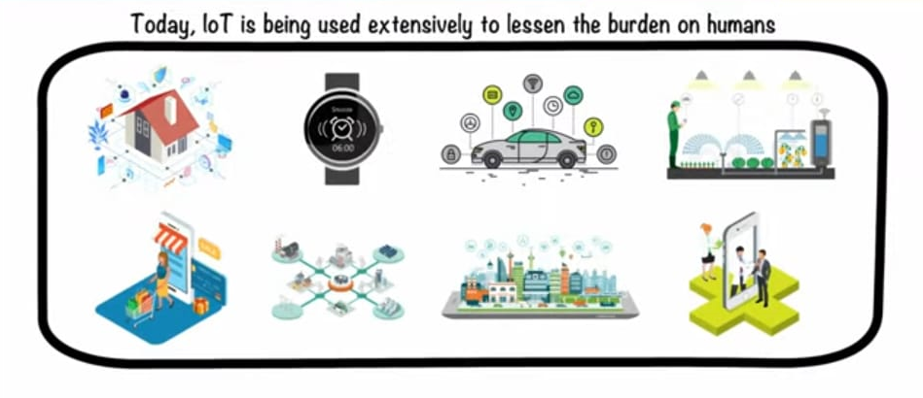

Slide 11
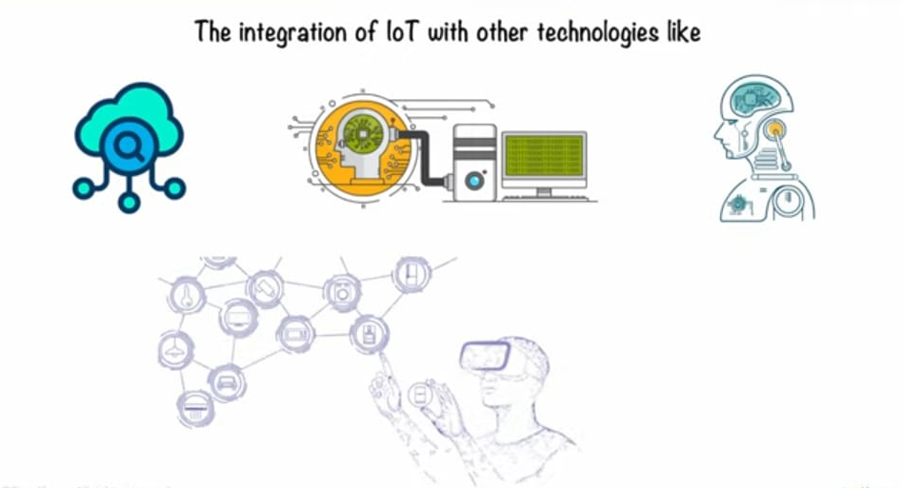

Slide 12
Challenges in implementation Of IOT
Sensing a complex environment
Connectivity
Battery backup
Security is vital
IoT is complex
Cloud is important

Slide 13

The IoT Market
As of 2013, 9.1 billion IoT units
Expected to grow to 80 billion IoT devices by 2025
Revenue growth from $1.9 trillion in 2013 to $7.1 trillion in 2022
1 billion = 100 cr
1 million = 10 lakh
1 Trillion = 1 million million million = 1 billion billion = 1,000,000,000,000,000,000

Slide 14

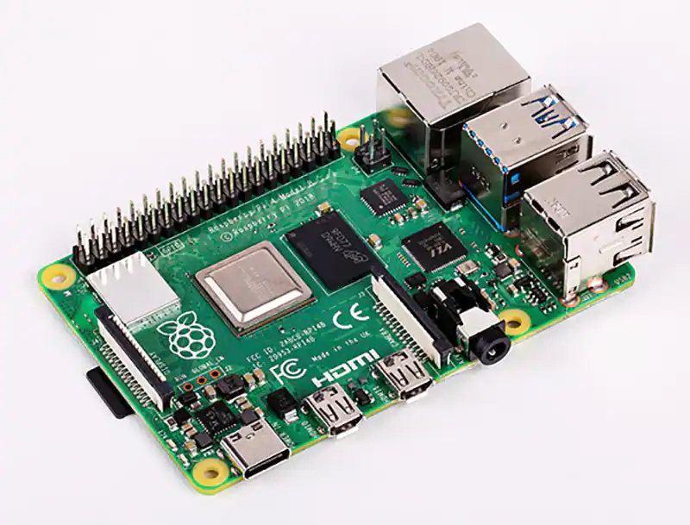
RaspberryPi

Slide 15
What is RaspberryPi?
Credit Card size single board computer or a programmable PC
Developed in U.K. by Raspberry-Pi foundation in 2009
Concept initiated by Eben Upton who works at Broadcom
Supported by “University of Cambridge Computer Laboratory & Broadcom”

Slide 16
Work on Linux based open source OS Raspbian
Consume less than 5W of power
Supports full HD video
Broadcom BCM2853 SOC
ARM11 core 700 MHz
RAM 256Mb, 512Mb, 1Gb,4 Gb

Slide 17
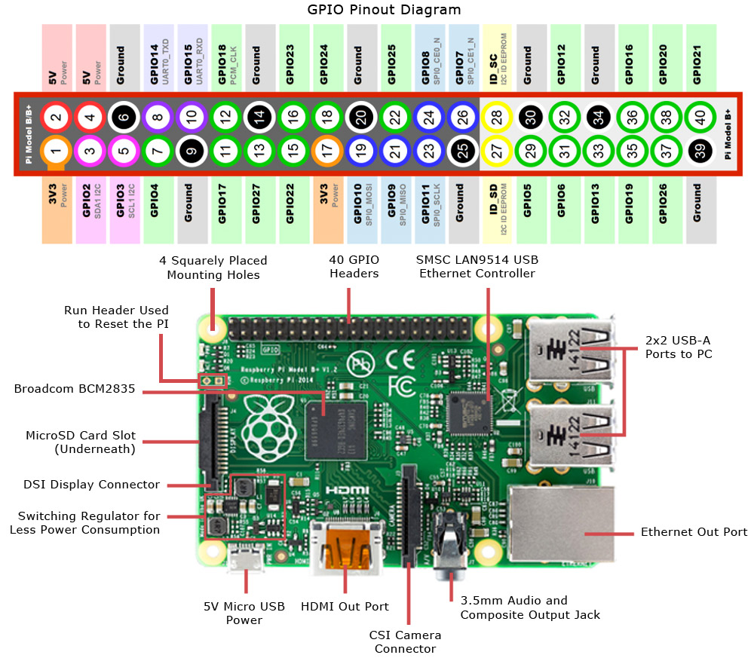

Slide 18
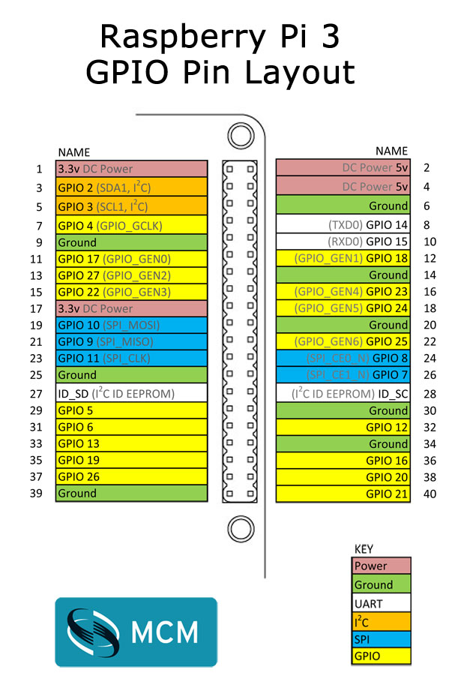

Slide 19
Applications:
Industrial Process Monitoring System
Logistic
Vehicle Tracking
Medical Field
Consumer Electronics
Smart Home

Slide 20
MDB Electrosoft Pvt. Ltd.
9552811938
9604922180
www.mdbelectrosoft.in
YouTube
MDB Electrosoft

